Slide 1
2.5 Overview of UML

Slide 2
2.5 UML Fundamentals and Notations
What is UML?
The Unified Modeling Language (UML) is a standardized general-purpose modeling language used to visualize, specify, construct, and document the artifacts of a software system.
Why use UML?
  Visual Clarity: Creates a blueprint for complex systems.
  Common Language: Facilitates communication between developers, analysts, and stakeholders.
  Reduces Ambiguity: Provides precise syntax and semantics for diagrams.
Three Main Types of Diagrams:
  Behavior Diagrams: Show how the system behaves.
  Interaction Diagrams: A subset of behavior diagrams focusing on object interactions.
  Structure Diagrams: Show the static structure of the system.

Slide 3
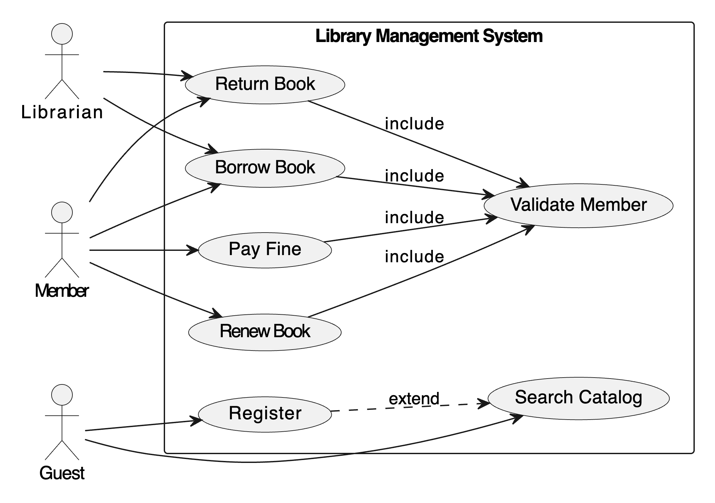
2.5.1 Behavior Diagram
Use Case Diagram (LMS):
  Purpose: Shows the functionality of a system from the user's perspective. It summarizes the relationships between actors and use cases.
  Shows actors (Member, Librarian) and system interactions like Borrow Book, Return Book, Add New Book.
Notations:
  System Boundary: The rectangle.
  Actor: Stick figure.
  Use Case: Oval.
  Association: Solid line.
  «include»: Mandatory relationship. E.g., Borrow Book includes Validate Member.
  «extend»: Optional/conditional relationship. E.g., Register can extend Search Catalog for a Guest.

Slide 4
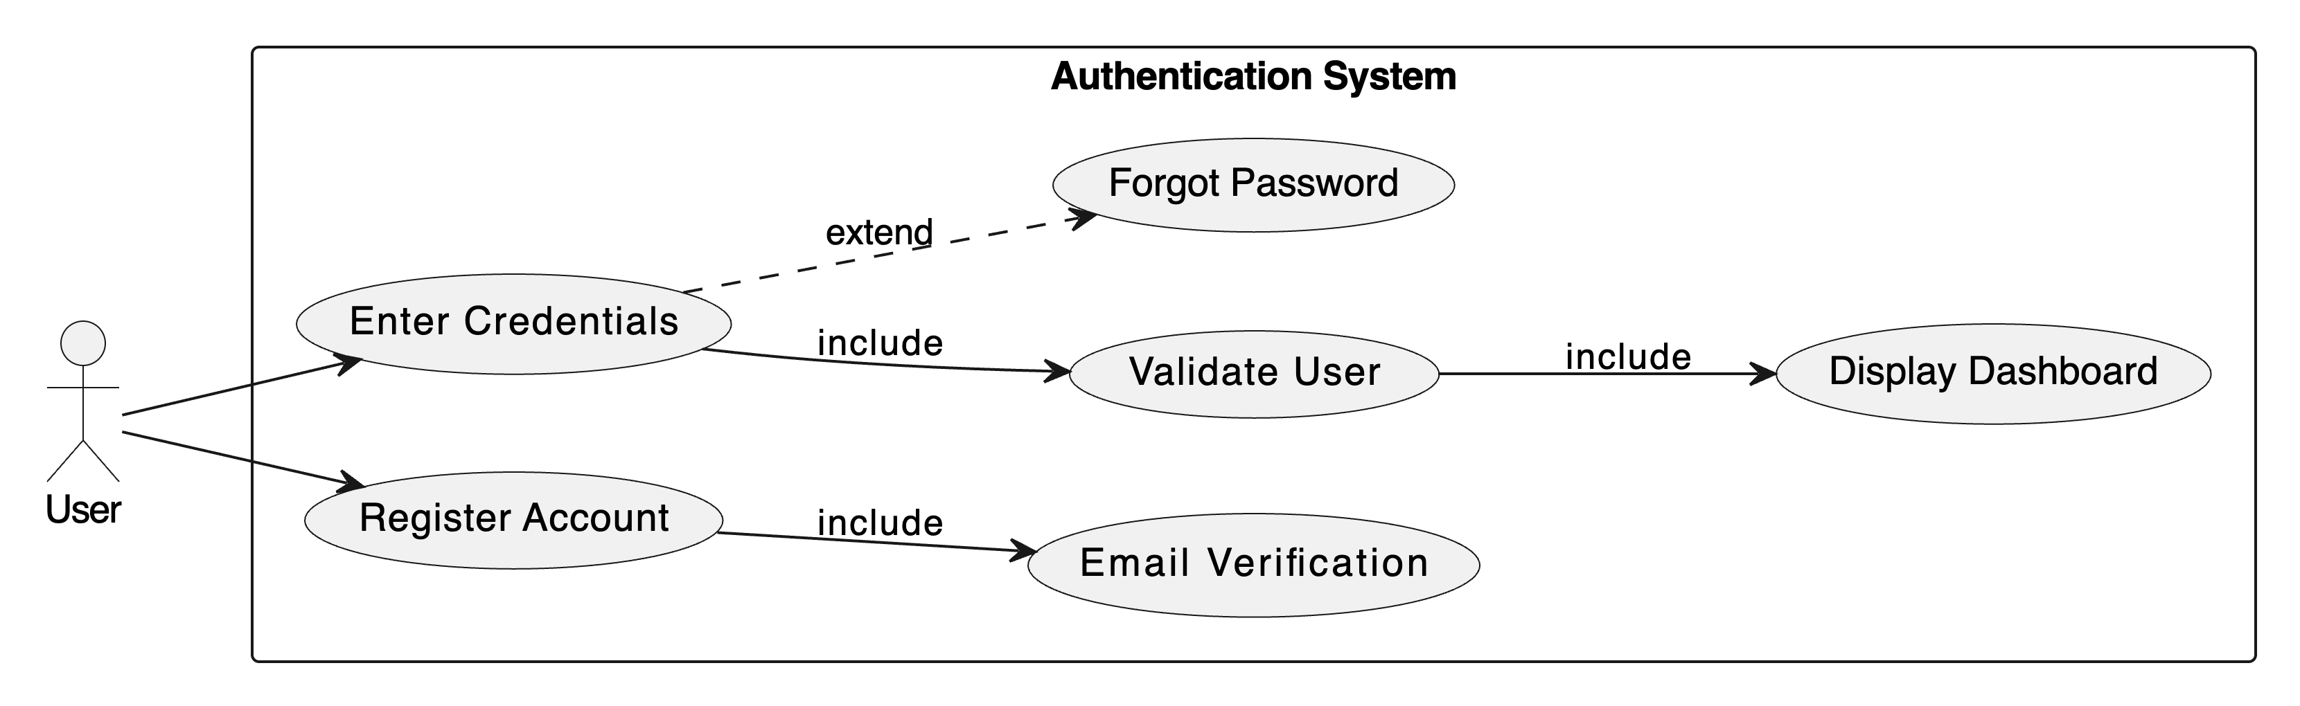

Slide 5
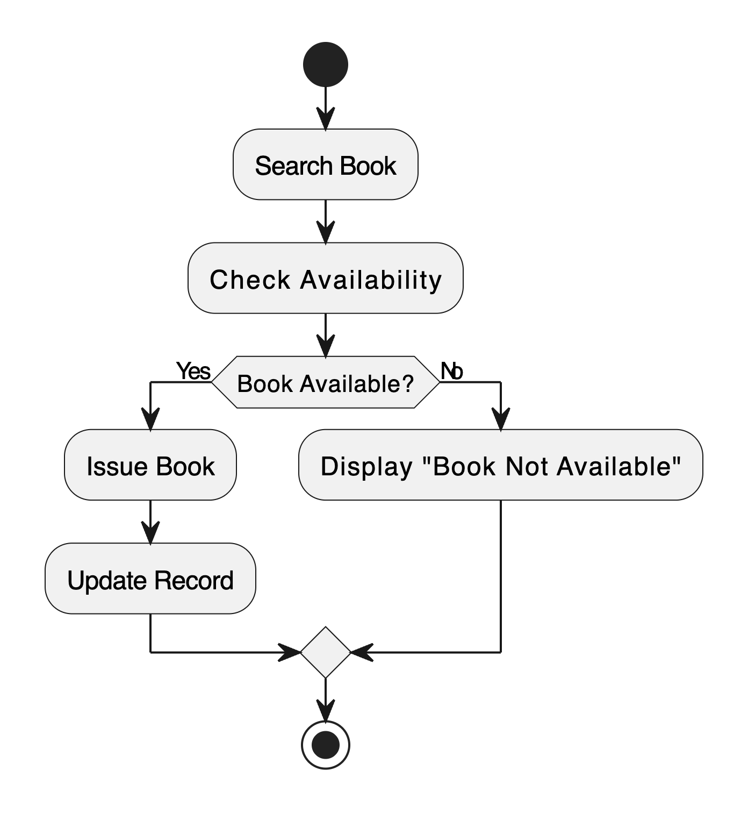
Activity Diagram (LMS):
  Purpose: Models the workflow or business process from start to finish. It shows the flow of control.
  Displays flow for Book Issue Process:
    Start → Search Book → Check Availability → Issue Book → Update Record → End.
Notations:
  Start Node: Solid circle.
  Activity: Rounded rectangle.
  Decision Node: Diamond.
  Flow/Edge: Arrow.
  End Node: Bull's eye.

Slide 6
2.5.2 Interaction Diagrams
Sequence Diagram (LMS):
  Purpose: Shows how objects interact in a time-ordered sequence. It emphasizes the order of messages.
  Actors and objects exchange messages over time.
    Example: Member → SearchBook → System → Database → Result → Issue Confirmation.
Notations:
  Lifeline: Vertical dashed line.
  Activation Bar: Rectangle on lifeline.
  Message: Horizontal arrow with label.
  Return Message: Dashed arrow.

Slide 7
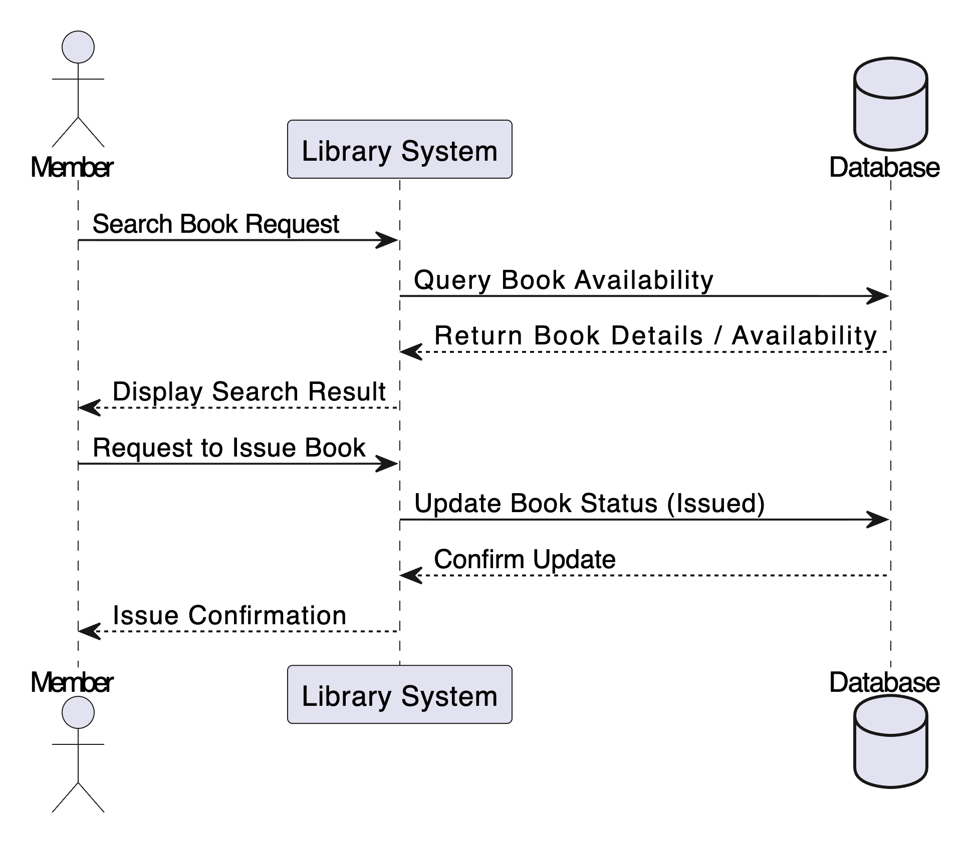

Slide 8
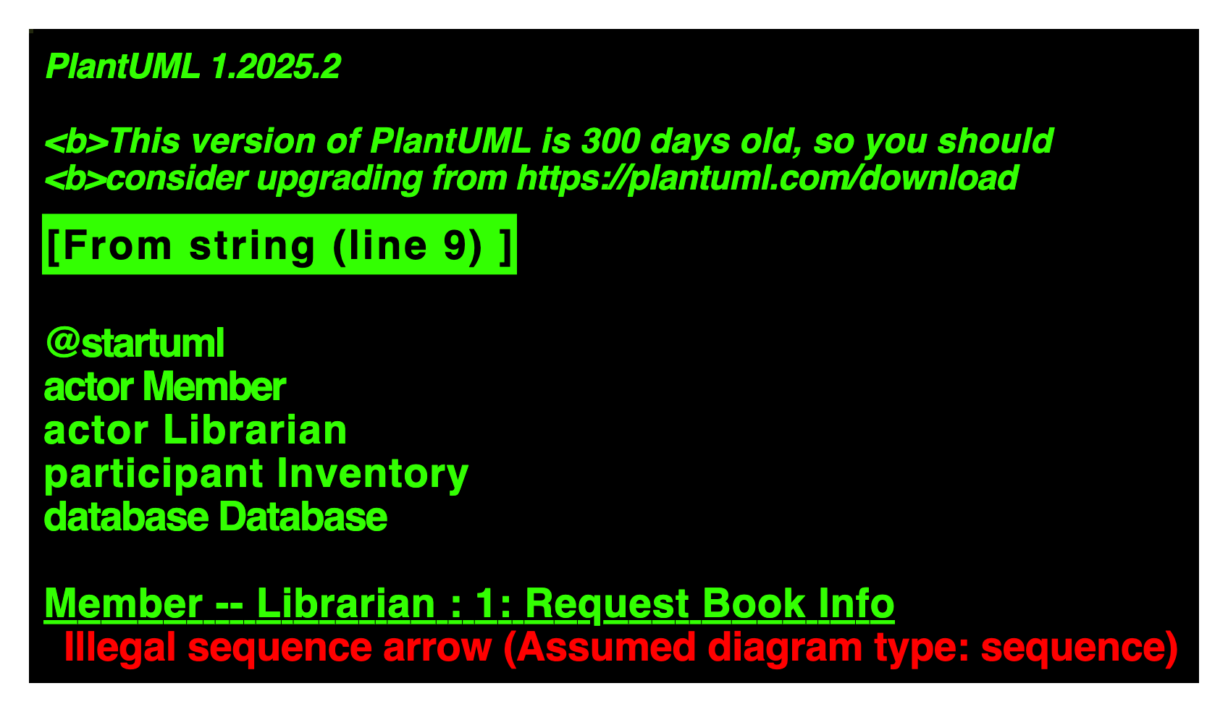
Communication Diagram (LMS):
  Purpose: Shows the interactions between objects, but focuses on the links between them rather than the time sequence.
  Emphasizes object relationships: Member ↔ Librarian ↔ Inventory ↔ Database.
Notations:
  Object: :ObjectName
  Link: Solid line between objects.
  Message: sequenceNumber: message along the links.

Slide 9
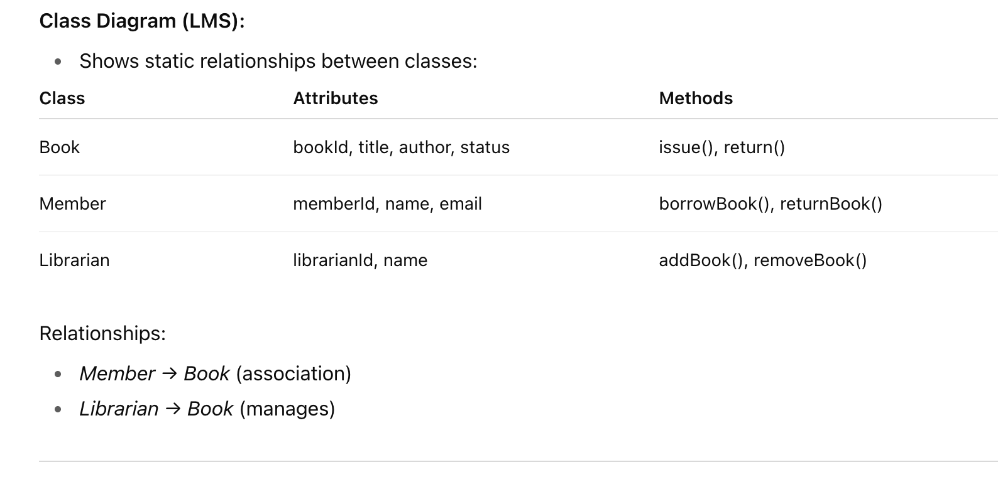
2.5.3 Structure Diagrams
Class Diagram
  Purpose: Shows the static structure of the system, including classes, their attributes, operations, and relationships.

Slide 10
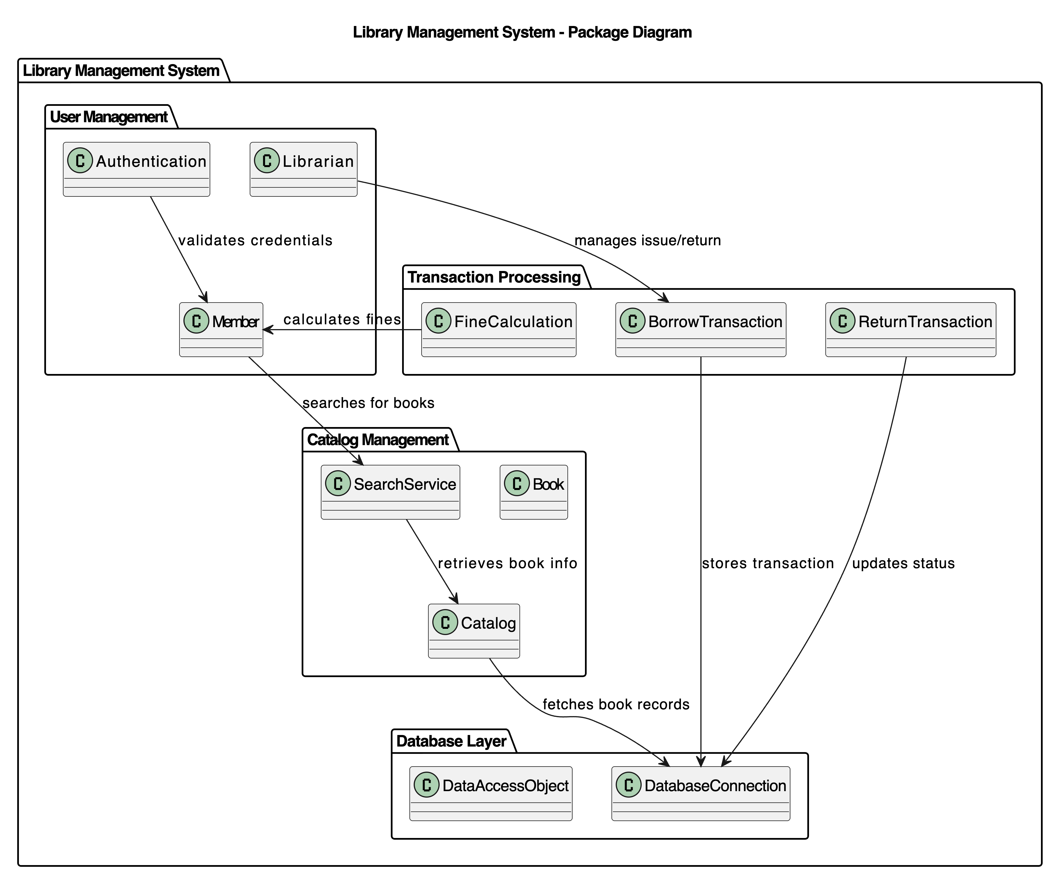
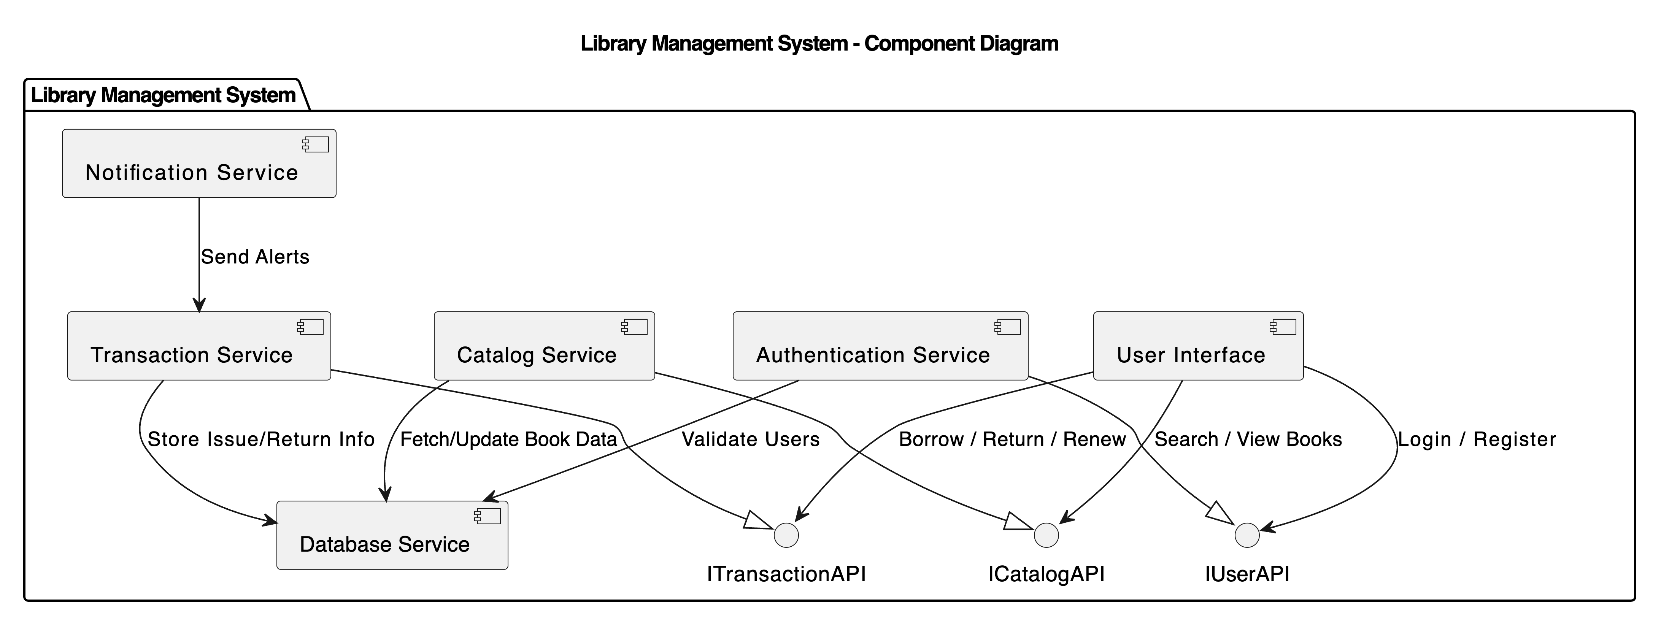
2.5.3 Structure Diagram: Package & Component Diagrams
Package Diagram
Purpose: Groups related elements into higher-level units to manage complexity.
Component Diagram
Purpose: Shows the physical or logical components of a system and their dependencies.

